Slide 1
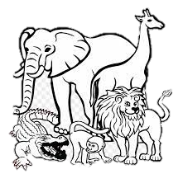
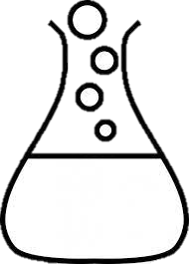



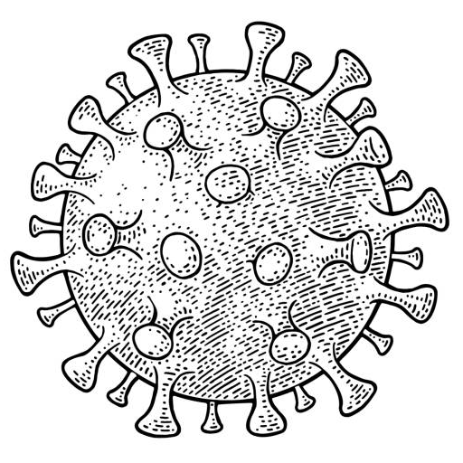

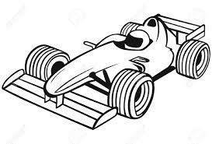
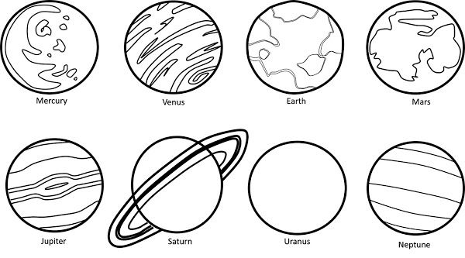


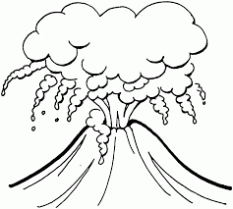
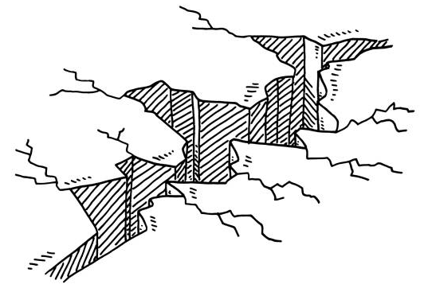
Biology
Chemistry
The study of life
The study of chemicals
animals
plants
materials
Biologists study ________, _________,
_________ and __________.
Chemists study ___________ and
_________.
bacteria
viruses
reactions
Physics
Astronomy
The study of energy and matter
The study of space
Geology
The study of rocks
motion
heat
Physicists study ________, _________,
______________ and __________.
electricity
light

Slide 2
Chemistry
The study of life
The study of chemicals
Biologists study ________, _________,
_________ and __________.
Chemists study ___________ and
_________.
The study of energy and matter
The study of space
The study of rocks
Physicists study ________, _________,
______________ and __________.

Slide 3
Astronomy
Biology
Physics
Geology
plants
animals
light
heat
viruses
electricity
materials
motion
bacteria
reactions

